Slide 1

Computational Thinking
By Jack Morrison

Slide 2
What is Computational Thinking?
Get complex problem.
Understand what the problem is.
Develop possible solutions.
Present these solutions.
Notes:
Computational thinking allows us to take a complex problem, understand what the problem is and develop possible solutions. We can then present these solutions in a way that a computer, a human, or both, can understand.

Slide 3
The four cornerstones of Computational Thinking
Decomposition
Pattern recognition
Abstraction
Algorithms
Notes:
There are four key techniques (cornerstones) to computational thinking:
Decomposition – this is breaking down a complex problem into smaller, more manageable parts, which are therefore easier to work with, and find a solution for.
Pattern Recognition – looking for similarities between problems, but also within each problem. If something repeats frequently in the problem, then this may be used to find a solution to the problem.
Abstraction – this means that you are only focusing on important details, and ignoring anything that is irrelevant, which will allow you to get to a solution faster.
Algorithms – these are step-by-step solutions to the problem which can be developed, or they could also be what rules you need to follow to get to a solution of the problem.
You need all four cornerstones when programming, as they all need to be applied to break down a problem, find the relevant detail and patterns, and develop a solution.

Slide 4
Computational Thinking vs Programming
Computational Thinking = planning what to tell the computer it has to do to get to the solution.
Programming = telling a computer what to do and how to do it.
Notes:
Simply put, programming tells a computer what to do and how to do it.
Computational thinking enables you to work out exactly what to tell the computer to do, which means you are planning what to tell the computer it has to do to get to the solution.

Slide 5

Example of Computational Thinking
Notes:
Here is an example of computational thinking.
Say you wanted to plan a trip to a theme park.
The first step is decomposition, so you all need to break down what rides you want to go on, how you will get there, how much money you want to spend, and how much time you have.
The next step is pattern recognition, so you would see what most people want to do, or how much most people want to spend on things to make everybody happy.
Then is abstraction, where you get rid of any plans that only one or two people want to do, so you can make time for what most people want to do.
Finally, you devise an algorithm, or a step by stem solution, which will allow you to plan a day that suits everybody.
You could also use a computer to help you to collect and analyse all of the data to devise the best solution to the problem, both now and if it arose again in the future, if you wished.

Slide 6
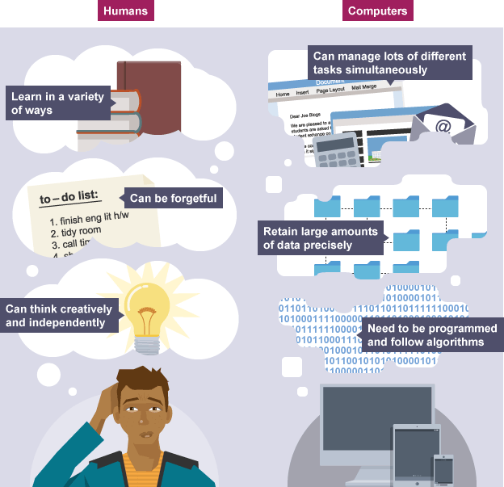
Conclusion
Computational Thinking – understanding how to represent a problem in a way that a computer will be able to solve.
Notes:
In conclusion, computational thinking basically means understanding how to represent a problem in a way that a computer will be able to solve. This involves breaking down problems into a series of logical steps such as an algorithm.
You can use computational thinking to think about how to translate real-world processes for a computer to understand. These are things a human could do without a list of instructions, but if a robot was asked to do it, it would need a series of clear, basic steps to follow.
This is because humans can think independently, whereas computers need to be programmed, and can’t think for themselves, at least for now anyway, with the development of more intelligent AI.
The process to find a solution would need to be broken down into a series of detailed, simple, logical steps using computational thinking, which shows how computational thinking can be applied to the real world.

